Slide 1

2023 – 2024
Notes:
Thank you joining
Philosophy
Summer Schedule
Tryout Information
Program Details

Slide 2
Mission Statement to develop young men with fundamentally sound basketball skills and strong court awareness, WHO exhibit sportsmanship at all times on and off the court, and understand the importance of community service.

Slide 3
JCATS Board Members
Volunteer Name | Committee | Position
Don Scheuneman | President | President
Kyle Hanson | Vice President, Tournament Director | Vice President
Kate Luxon | Treasurer, Social Media Coordinator, Referee Coordinator | Treasurer
Matt Leyva | Secretary, Tryout Coordinator | Co-President, Secretary
Jeff Nutschnig | Legal Consult, Concessions & Away Tournament Coordinator | Board Member
Kelly Epley | Scheduling Coordinator, LHS Liaison | Board Member
Megan Guerrant | Scheduling Coordinator | Board Member
Peter Silvestri | Director of Coaches and Tryouts | Board Member
Kristin Sorensen | Uniform Coordinator | Board Member
Maggie Barrett | Webmaster, Team Parent Liaison | Board Member
Mike Dillon | Banquet Coordinator | Board Member
Scott Cairns | Philanthropy | Board Member
Andy Kozar | Team Picture Coordinator | Board Member

Slide 4
PLAY TO Win
What is JCATS Philosophy
With ALL Players

Slide 5
Playing Time Philosophy
There will be no guaranteed minutes per game; however, it is our intention that playing time will balance out over the course of the season.
As players move from 4th to 8th grade, more emphasis will be placed on competing for playing time.
Playing time will vary by individual player according to his practice time, attitude, ability, progress, demonstrated commitment to the team, and compatibility with the needs of the team versus the competition.
Coaches are encouraged to start different lineups so that all players get starting experience.

Slide 6
Philosophy – Other Activities
We ask that you prioritize JCATS as the primary sport in the Winter
We support multi-sport athletes
We support Middle School Basketball Teams
We support family vacations
We support school activities – Band, Choir, etc.
School activities come first!
If he is sick, rest and stay home

Slide 7
2023 – 2024
Program Details

Slide 8
Team structure 2023 – 2024 (Subject to CHANGE)
# of Players: 134
# of Teams Per Level:
  4th Grade
    1 Team
    Orange Only
  5th 6th 7th and 8th Grade
    3 Teams per Age Group
    Orange – A, Black – B, White – C
# of Players Per Team (Subject to Change)
  10 Players Per Team – Orange and Black
  11 Players Per Team – White
  4th Grade team size may vary
  This may be adjusted at tryouts
Balanced Teams

Slide 9
Practice and Game Schedule (Subject to CHANGE)
Practice Schedule
Games
Practices Start Monday, October 30th
All Teams Practice Twice a Week (Monday – Thursday)
  5th and 6th Grade: Early Slot 6:00 or 6:30 p.m.
  7th and 8th Grade: Late Slot 7:30 or 8:00 p.m.
Practice Schedules (Time and Location) are Subject to Change – You must check the website or App frequently
Locations: Sports Complex, Local Libertyville K-8 Schools and High School
Orange & Black Teams
  6 to 8 North Suburban Conference Games
  3 to 5 Independent Games
  5 to 7 Tournaments (3 Games Each)
White Teams and 4th Grade
  10 to 12 Play Hard Hoops Travel League
  2 – 4 Independent Games
  4 - 6 Tournaments (3 Games Each)
All Teams: Target 27 – 32 Games
Play Hard Hoops Schedule will not be loaded until mid to late December
4th and 5th Grade May See Reduced Game Count (Not All Programs Have Teams)
Cancelled Tournaments Not Replaced
20 Min Running Clock - Tournaments
IHSA Rules Individual Games

Slide 10
Example: Tournament Schedule
Team | Riverside Nov 19-20 | PHH Nov 19 – 20 | Lake / Dupage Dec 18 | Deerfield Jan 13-15 | GBN MLK Jan 15 – 16 | Matto Jan 26 | Feeder Frenzy Jan 29 | Ridgewood Jan 27 -29 | Hersey Feb 17 – 19 | Deerfield Feb 25 – 27 | McHenry | PHH March 5 - 6
8A | X |  | X |  | X |  | X |  | X
8B | X |  | X |  | X | X |  | X | X | X
8C |  | X |  | X |  |  |  |  |  | X |  | X
7A | X |  | X |  | X |  | X |  | X
7B | X |  | X |  | X | X |  | X | X | X
7C |  | X |  | X |  |  |  |  |  | X |  | X
6A | X |  | X |  | X |  | X |  | X
6B | X |  | X |  | X | X |  | X | X | X
6C |  | X |  | X |  |  |  |  |  | X |  | X
5A | X |  | X | X |  |  | X |  |  |  | X
5B | X |  | X | X |  | X |  | X |  | X
5C |  | X |  | X |  |  |  |  |  | X |  | X

Slide 11
Coaches 2023-2024
Grade | Orange | Black | White
4th | Pete Silvestri
5th | TBD | TBD | TBD
6th | TBD | TBD | TBD
7th | TBD | TBD | TBD
8th | TBD | TBD | TBD
All Coaches complete a background check
Head Coach & Assistant for every team
Preference: Paid Coach For All Teams
Parent coaches are assigned as needed
Parent coaches are decided after the teams are selected
Parents can volunteer to be an assistant

Slide 12
Offense and defense – All Grades
Primary Defense: Man-to-Man
  Ball Pressure
  Press as needed
Offense: FLEX
  This requires all players to play the post and guard positions
  All players will learn spacing, timing, screening, moving without the ball, cutting and replacing, catching the ball in triple threat, ready to catch and shoot
Transition: Push the ball up court under control

Slide 13
2023 – 2024 tryout Information

Slide 14
Tryouts
Monday, October 16th & Tuesday, October 17th
5th grade 6:30 pm – 7:45 pm
7th grade 8:15 pm – 9:30 pm
Wednesday, October 18th & Thursday, October 19th
6th grade 6:30 pm – 7:45 pm
8th grade 8:15 pm – 9:30 pm
Location:
LHS Field House (4th Grade – Canlan Libertyville)
Please Arrive 15 Minutes Early on the first day to pick up your pinnie
The Boys MUST wear their Pinnie (Provided on the 1st Night of Tryouts)
The Pinnie is their Tryout Number
Basketball
Please write name on Basketball
4th and 5th Grade 28.5 / 6th – 8th Grade 29.5
Preferred Ball: Wilson Evolution (Not Mandatory)
Players must enter / exit through the front entrance!
Sunday, October 15th
4th grade 4:30 pm – 6:00 pm

Slide 15
Tryout Process
Each player is assigned a number (Pinnie)
Evaluators will only have access to players number (No Name, No Previous Team Name, No Dads Height, No Soccer or Baseball Level, etc.)
Minimum of 6 evaluators at each session
All evaluator’s votes are equal
No Parents, Board Members or Coaches with kids in the program can view or participate in the tryout process for their age group
We will run the boys through a series of individual and team drills
The players will be matched up against different levels of talent during the process

Slide 16
Acceptance of Roster Spot
Top 31 Players will be released no later than Saturday, October 21st by noon.
Parents must register and make $800 payment by Tuesday, October 24th at 5 p.m.
Payment accepted online only
Digitally Sign Code of Conduct
Digitally Approve or Decline Photo Usage
Volunteer Opt-Out Option
Complete Medical Form
If you decide not to accept a spot on a team, please let us know right away.

Slide 17
Team Placement
Each age group will practice together as a team on Monday, October 30th (4th, 5th, 6th, 7th & 8th Grade)
Tryout evaluators will provide our coaching staff with their recommendations based on tryouts
During practice, the boys will be matched up against each other on drills and scrimmages.
The coaching staff will work together to determine final spots
It is not the decision of one person
It is a practice, and we will begin introducing our philosophies on offense and defense
Final Rosters are posted by Wednesday, November 1st

Slide 18
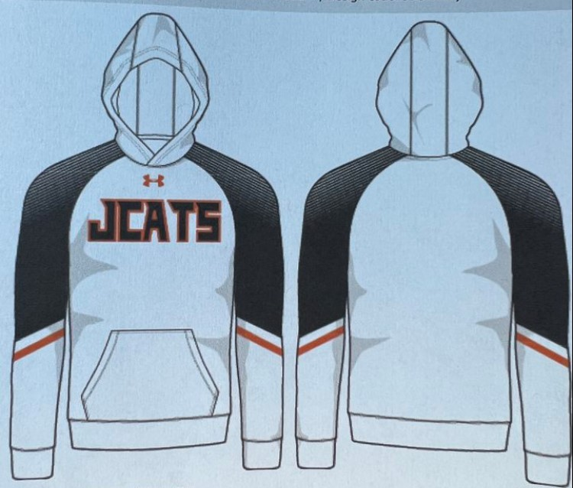
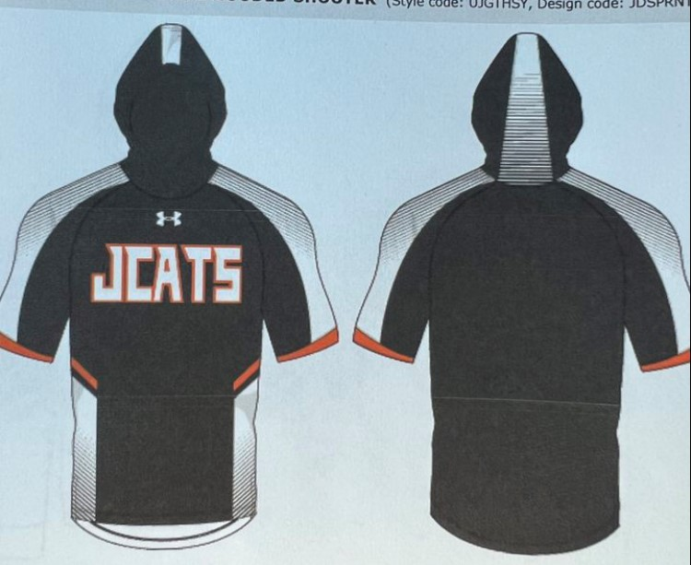
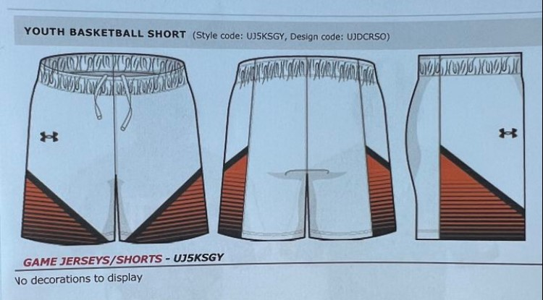
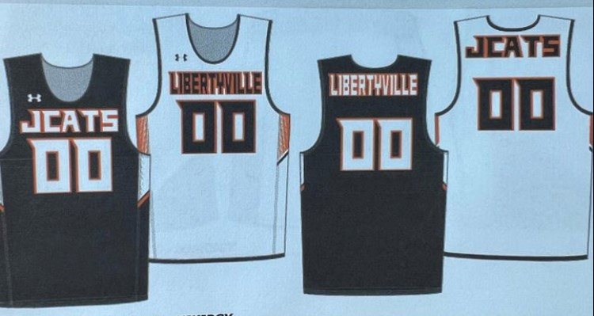
Ordering JCATS UNIFORMS – Sports 11
Please order by Thursday, October 26th!
Mandatory
  Jersey
  Shorts
  Socks
Optional
  Shooting Shirt
  Sweatshirt
Undershirt
  White on White (Home)
  Black on Black (Away)

Slide 19
2023 – 2024
Additional Details

Slide 20
Parent Volunteer Program
Parents are required to volunteer for a 3-hour shift (per player) at one of the two home tournaments or pay $100 opt out fee per player ($150 family maximum).
Any parent who is a coach or assistant coach will not be required to complete additional volunteer hours regardless of the number of children they have participating in the program.
Any parent who is a team parent will have met the volunteer requirement for one player. If you have more than one child who is a participant in the program, they will need to complete additional volunteer hours as required.
If a parent registers but does not show up for selected tournament shift, a non-compliance penalty of $100 will be assessed.

Slide 21
End of Year Banquet (Subject to Change)
Tuesday, March 5th in the Libertyville High School Cafe
Pizza, Pasta and Salad
All Grade Levels and Teams
“Matto” Award Presentations
7th Grade Families:
  Responsible for decorations and room set up
  3 volunteers from each team
  Arrive at 5:45 to set up for 6:30 start
8th Grade Families:
  Responsible for serving food and clean up
  8 Orange Families: Case of Water
  8 Black Families: Cookies
  8 White Families: Brownies or other baked good

Slide 22
JCATS Sideline etiquette
Avoid ‘coaching’ from the sideline while watching your child’s game
Focus on the benefits of the game rather than the score
Think when interacting with opposing fans
Don’t stress out over the game
Save issues with the coach for the next day
Do not criticize the referee
  National Association of Sports Officials, indicating more than 75 percent of all high school officials say “adult behavior” is the primary reason they quit. And 80 percent of all young officials hang up their stripes after just two years of whistleblowing. It has caused a shortage of Refs.
Just ENJOY the game!

Slide 23
Thank You
2023 – 2024

